Slide 1
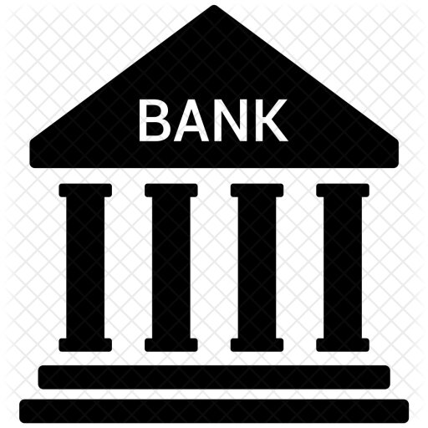
Banking Services During COVID-19

Slide 2
Banking Sector
A “Bank” is a financial body which is involved in borrowing and lending money. Banks take client deposits in return for paying customers an annual interest of payment. The bank then uses the bulk of those deposits to lend to alternative customers for a variety of loans.
Banks play a vital role within the economy for giving for people wishing to save. Banks additionally play a vital role in giving finance to businesses. These loans and business investment are necessary for a sanctionative economic process.

Slide 3
Overview of This during Covid-19
Main purpose of banks are:
Keep cash safe for customers.
Offer customers interest on deposits, serving to guard against cash losing price against inflation.
Lending cash to companies, customers, and home buyers.
Offering monetary recommendation and connected monetary services, like insurance.
Banks certainly have their hands full in light of the novel coronavirus occurrence (COVID-19). Borrowers and businesses face job losses, slowed sales, and declining profits because the virus continues to unfold around the world. Banking customers have already begun seeking monetary relief, and regulators in India are encouraging banks to assist them.
Several banks are already getting down to encourage remote operating of some staff members.
By implementing completely digitized and remote client transactions, banks will make sure that every day and exceptional processes are allotted out with restricting interruptions.
The World Health Organization(WHO) has suggested people to use contactless payment and avoid handling banknotes as the coronavirus might still survive on banknotes for days, fast unfolding of the disease.

Slide 4
History of Banking Service in India
Modern banking started in the later half of the 18th century. The first bank of India was the “Bank of Hindustan”, established in 1770 and was located in the then Indian capital, Calcutta. However, this bank failed to work and ceased in 1832 [2] .
The largest and the oldest bank which is still there is State Bank of India(S.B.I). It originated and started working as the Bank of Calcutta in 1806. In 1809, it was renamed as the Bank of Bengal. This was one of the three banks founded by a presidency government, other two were the Bank of Bombay in 1840 and the Bank of Madras in 1843. These three presidency banks were merged in 1921 to form Central Bank of India, which upon India’s independence became the State Bank of India in 1955.
The Banking sector development can be divided into three phases:
Phase1: The Early phase which was from 1770 to 1969
Phase2: The Nationalisation phase which lasted from 1969 to 1991.
Phase3: The Liberalisation or the Banking Sector Reforms Phase which begin in 1991 and continues to flourish till date.
During this Pre independence period over 600 banks had been registered in the country, but only a few managed to survive

Slide 5
Evolution of role and motive of Banking
Loans are essentials to modify companies to take a position and expand. However, banks don't seem to be the sole supply of finance. Companies might turn to private investors, stock exchange, government grants or personal savings.
In times of recession or shortage of funds, banks might not be willing to lend.
Bank loaning is profitable for banks and may incur consequential prices for the firm.
Consumers would like banks to pay bills electronically.
Bank loans and mortgages offer a chance to buy expensive things, and pay back over a long period e.g. house, car.
Low-income customers might feel they can't afford insurance payments and place themselves in risk.

Slide 6
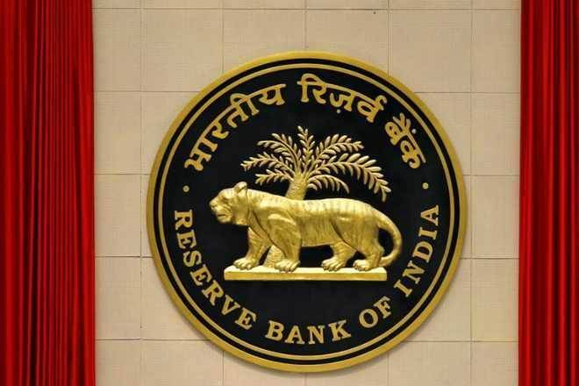
Banking Regulation in India
The banking system in India is regulated by the Reserve Bank of India (RBI), through the provisions of the Banking Regulation Act, 1949.
The BR Act provides a framework for supervision and regulation of all banks. It also gives the RBI the power to grant licences to banks and regulate their business operation. FEMA is the primary exchange control legislation in India. FEMA and the rules made there under regulate cross-border activities of banks.

Slide 7
Banking Regulation in India
The key regulator for the banking system in India is the Reserve Bank of India (RBI). The RBI is the central bank of India and the primary regulatory authority for banking. An entity intending to carry out banking business in India must obtain a licence from the RBI.
India has several other financial sector regulators, including the:
(i) National Housing Board (NHB), which is the regulatory authority for HFCs in India
(ii) Securities Exchange Board of India (SEBI), which is the regulatory authority for the securities market in India
(iii) Insurance Regulatory and Development Authority of India (IRDAI), which regulates the insurance sector.
The key statutes and regulations that govern the banking industry in India are
Reserve Bank of India Act, 1934 (RBI Act): The RBI Act was enacted to establish and set out the functions of the RBI. The RBI Act empowers the RBI to issue rules, regulations, directions and guidelines on a wide range of issues relating to the banking and the financial sector.
Banking Regulation Act, 1949 (BR Act): The BR Act provides a framework for the supervision and regulation of all banks. It also gives the RBI the power to grant licences to banks and regulate their business operation. The BR Act also sets out details of the various businesses that a bank in India is permitted to engage in.
Foreign Exchange Management Act, 1999 and the rules and regulations issued thereunder (FEMA): The FEMA is the primary legislation in India which regulates cross-border transactions and related activities. FEMA and the rules made thereunder are administered by the RBI.

Slide 8
Loan Policies During COVID-19
• Coronavirus had a durable effect on numerous enterprises including banks. Post-emergency, computerized development, and COVID-19 flexibility will decide the methodology of banking players with three fragments.
• The government and the Reserve Bank of India have come out with a monetary upgrade and various alleviation measures to shield the economy from the unfriendly effect of the continuous Covid-19 emergency.
• Presently, these involve an enormous number of declarations that will legitimately or by implication advantage the ordinary citizens.

Slide 9
• India facilitated some loaning rules in the salvage bundle it reported in May 2020 during covid period to enable all the more independent companies to hold over the emergency set off by the pandemic. The government has expanded the furthest reaches of credits remarkable as of Feb. 29 to Rs 50 crore from Rs 25 crore.
• India's government in May revealed a Rs 21 lakh crore bundle to help the economy, including facilitating admittance to loan for private ventures and offering modest advances to laborers and farmers.
• India in May reported a bundle offering delicate credits worth Rs 3 lakh crore to private ventures and said the advances will be ensured by the government.

Slide 10
• To facilitate the advance reimbursement commitment in the midst of the lockdown and the financial log jam, the RBI has additionally expanded the ban time frame on all advance EMIs and credit card by an additional three months, i.e., till August 31, 2020.
• Individuals who can't clear their obligations attributable to the Covid-19 mishap and related issues can select this reimbursement suspension without defaulting. The non-installment of EMIs during the ban time frame will likewise not sway their CIBIL scores
Loan Moratorium Extension

Slide 11
• Few banks are consequently passing the ban office to borrowers who can't pay their current advance EMIs or credit cards, others have approached their clients to decide on it manually.
• Along these lines, in the event that you don't have a significant liquidity issue, you'll be all around encouraged to proceed with your advance reimbursements without the assistance of the ban, particularly in the event that you've recently started reimbursing a long term loan like a home loan.

Slide 12
• The RBI, through a notice dated March 27, 2020, revealed a measure by allowing every business bank, co-usable banks, AIFIs, and NBFCs to concede a ban of a quarter of a year on all term advances just as on working capital offices on the installment of all portions exceptional as on March 1, 2020.
• Considering the expansion of the lockdown and proceeding with disturbances because of COVID-19, RBI has chosen to allow loaning foundations to expand the ban on term advance portions by an additional three months, i.e., from June 1, 2020, to August 31, 2020, vide warning dated May 23, 2020.
• Banks are likewise being urged to keep credits worth Rs 60,000 crore prepared.
Rescheduling of Payments - Term Loans and Working Capital Facilities

Slide 13
Most organizations are searching for budgetary help from the public authority and doing this can assist them with adapting to income issues. Loosening up terrible credit standards could likewise be a sparing move for this area.
• Public moneylender, Indian Bank has reported 5 crisis emergency loans during the lockdown time of the Covid pandemic to guarantee the spread of Covid is contained.
The 5 crisis emergency loans are for their corporate customers, MSMEs, SHGs, Retail borrowers, and Pensioners.
Delay MSME loan repayments or extend the period

Slide 14
IND-COVID Emergency Credit Line (IBCECL) for Corporate:
Extra financing will be given up to 10% of the working capital cutoff points with a limit of Rs 100 crore. This advance office will be appropriate for enormous corporates and medium undertakings for a time of three years.
IND-MSE COVID Emergency Loan—(INDMSE-CEL) for MSME:
An extra subsidizing of 10% of FBWC limits with max Rs 50 lakhs will be made accessible for all MSMEs for a very long time tenor to guarantee MSMEs are not inferred off liquidity during these difficult occasions.

Slide 15
SHG-COVID - Sahaya LOAN for Self Help Groups:
Servicing more than 1.68 lakh SHGs including 22 lakh ladies recipients and to assist them with going through the emergency every part will be qualified to benefit a delicate advance of Rs 5000 which amounts to Rs 1 lakh for each SHG. Credit length would be for three years with a 6-month moratorium.
IND-COVID Emergency Salary Loan for Retail borrowers:
Salaried representatives will be given a loan to a sum comparable to multiple times of the most recent month to month net compensation – subject to a maximum of Rs 2 lakh. All charges and concessional interest will be deferred off, credits are for pressing clinical and different consumptions.

Slide 16
Fifteen times of monthly pension with a limit of Rs 2 lakh will be permitted with 60 months reimbursement with concessional interest and charges to be deferred off.
• The Reserve Bank of India (RBI) has given rules for recast or goal of credits taken by singular borrowers who are confronting monetary challenges because of the Coronavirus pandemic. Banks need to define their own approaches on the recast of such credits based on these rules.
IND COVID- Emergency Pension Loan for Pensioners:

Slide 17
Understanding the Demand and Supply
The friction in the demand and supply industry, role of banks and what do the customers want.

Slide 18
No bank is ready to give loans because
A major reason why banks aren’t making fresh loans is uncertainty over the fate of their existing loans
Following the COVID-19-induced lockdown, borrowers were offered a moratorium on payment of any interest or principal amounts due between March 1 and August 31
RBI data shows around half of the total outstanding bank loans being under moratorium as on April 30
Give banks the freedom to decide on the borrowers whose loans are deserving of being restructured

Slide 19
How to balance Demand and supply
Creating conditions for banks to be in a position to “supply” credit will, of course, not solve the problem of “demand”
The government must spend — rather invest — to grease the wheels of commerce
Once the economy starts moving, it will not only revive credit demand, but also improve the cash flows and debt servicing abilities of firms

Slide 20
GDP
Gross domestic product (GDP) is the standard measure of the value added created through the production of goods and services in a country during a certain period.

Slide 21
GDP
The GDP for the first quarter, April-June fell by 23.9%, an effect of the lockdown, the biggest decline in four decades, the country has ever seen.
Compared to India, the countries which were worst hit, USA and China’s GDP contracted by 9.1% and 17% respectively.
The government tried increasing the spending by 16%, but it was not adequate to compensate for the decline suffered by other engines of growth.
To arrest the spread of coronavirus almost all the economies were under strict lockdown which influenced almost every sector and hence GDP.
Other factors influencing GDP
demonetisation of 2016
step of CGST implementation
The GDP downfall takes us somewhere back to 45 years

Slide 22
GDP contribution by Banking sector
Low rate of borrowing, MSME’s taking more loans, instead of raising capital using debt funds or equities.
Transferring of money to Jan Dhan accounts by the Central government and some state governments, increasing money income of the people by directly providing them with money.

Slide 23
Continue...
Supreme Court provided relief to borrowers by charging no penalty or interest on the unpaid EMI’s and extended the moratorium period from August 31 to September 28.
Tie-up of various banks with big e-commerce websites like Amazon with ICICI and Flipkart with Axis Bank to provide discounts using their credit or debit cards. Recently AU Bank also tied up with Amazon.

Slide 24
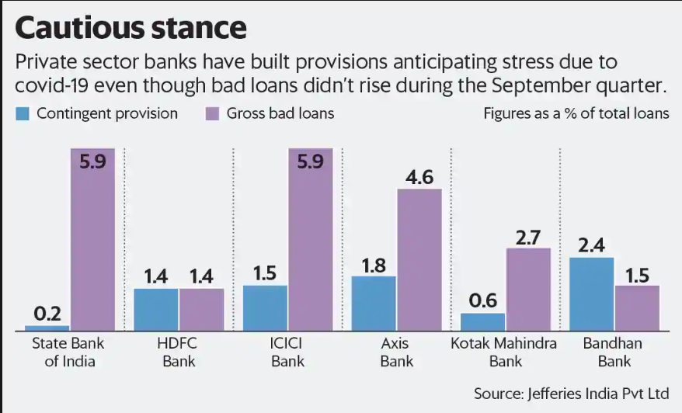
No rise in bad loans due to SC’s judgement, still banks are making provisions.

Slide 25
Survey- Talking with the Bank Managers (A Reality Check)
Bank credit growth to decline to ~2-3% over fiscal 2021.
Banks didn’t get any profits in 1st and 2nd quarter of this year (2020).
Banks are also providing funds to MSMEs, farms and retail sectors.
Industries are in the breathing phase.
Companies are not ready to take loans further.
There are no transactions going on between B2B.
Impulsive buying in B2C sector.
Loan seekers who work in such sectors as media, aviation and hospitality are having a hard time.
Banks are expecting that by March 2021 the picture will get cleared.

Slide 26
Continue...
Pandemic led economic downturn to result in lower credit growth, higher slippages and lower collections/resolutions which will in turn not only impact credit costs but also net interest income for the banking sector.
Banking sector to slip back into negative profitability in fiscal 2021.
The RBI is also monitoring the situation.
It can be seen that there should be an increase in deadweight loss.
Banks and the government are trying to lower it by implementing changes in policies

Slide 27
COVID-19 Effect on GDP
India's economic growth suffered its worst fall on record in the April-June quarter, with the gross domestic product (GDP) contracting 23.9 per cent. The coronavirus-related lockdowns mainly weighed on the already-declining consumer demand and investment.

Slide 28
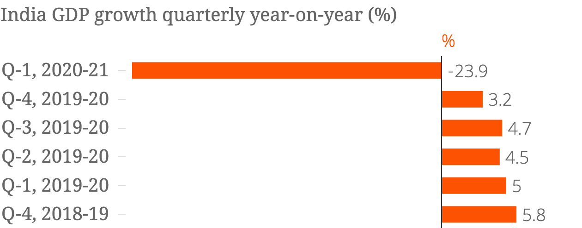
-23.9 contraction in GDP for the quarter, the first two months of which saw complete lockdown.
The GDP is likely to contract by 8.6 percent for the July-September period, which means India will enter into a recession for the first time in history in the first half of this fiscal with two successive quarters of negative growth due to the COVID19 pandemic, as per an RBI official. ( Q1 & Q2 0f 2020 )

Slide 29
Production of essentials was permitted during the lockdown, but fast-moving consumer goods (FMCG) firms faced a decline. Most people could not go to work, so roads were empty and offices and factories were shut. Government offices were also closed and only the essential administration and police were functional.
As the lockdown was eased in stages from May, activity started to recover. But it still could not have been more than 40% of the level in May 2019. In June with Unlock 1, more activity was allowed but by all accounts many services were not allowed and this sector constitutes 55% of the GDP. So, the economy could not have been working at more than 60%.

Slide 30
THE IMPACT OF CORONA VIRUS ON BANKING SECTOR
70% of banking sector debt affected by Covid-19 impact
The Indian economy was expected to lose over ₹32,000 crore (US$4.5 billion) every day during the first 21-days of complete lockdown, which was declared following the coronavirus outbreak. Under complete lockdown, less than a quarter of India's $2.8 trillion economic movement was functional. Because of this the Indian economy shrank 23.9 per cent year-on-year in the first quarter (Q1) of 2020.

Slide 31
Corona Measures taken by Banks
With the lockdown imposed to contain the spread of the coronavirus, banks are taking safety measures to safeguard their staff and customers. Banks across the country have changed timings of their branches, reduced staff. Banks are also pushing people to use digital channels instead of visiting the branch.
Banks have started maintaining provisions for bad loans, in case it defaults.
Common steps we’ve seen embrace establishing a central task force, curtailing travel, suspending large-scale gatherings, segregation teams , making arrangements for telecommuting , and refreshing external-vendor-interaction policies. On the far side these immediate and basic actions, banks ought to prioritize three measures tailored to the particular combination of biological and market stresses.

Slide 32
Conclusion
To ensure safety of people amidst the covid-19 outbreak, the Reserve Bank of India (RBI) governor, Shaktikanta Das, asked customers to use digital banking facilities as much as possible Das also added, "In the context of COVID 19, RBI and the government together are giving emphasis on encouraging digital payments. And over a period of time, several measures have already been taken to establish a safe, secure, stable and affordable retail payment system such as the National Electronic Fund Transfer (NEFT) and the Immediate Payment Service (IMPS)."
Several banks have made investments in technology and digital transformation over the past couple of years. A lot of them, however, are still heavily reliant on face-to-face interactions, supported by paper processes. So, we expect to see renewed vigor in the Indian financial services industry with banks making a collective effort to up their digital game. This will be critical as COVID-19 is likely to have a prolonged impact, and banking touches every part of our economy.

Slide 33
References
https://www.economicshelp.org/blog/glossary/banks/#:~:text=Banks%20play%20an%20important%20role,important%20for%20enabling%20economic%20growth
https://en.wikipedia.org/wiki/Banking_in_India#cite_note-BankOfficesCertainConcept-10
https://www.lexology.com/library/detail.aspx?g=a1976e5b-288e-4dce-be91-ecd57fc575c9#:~:text=The%20BR%20Act%20provides%20a,and%20regulate%20their%20business%20operation.&text=FEMA%20is%20the%20primary%20exchange,cross%2Dborder%20activities%20of%20banks
https://www.complybook.com/blog/banking-regulation-in-india#:~:text=The%20key%20regulator%20for%20the,a%20licence%20from%20the%20RBI
https://www.financialexpress.com/industry/banking-finance/rbi-proposes-major-changes-in-securitisation-norms/1985336/ RBI logo
https://iconscout.com/icon/bank-account-banking-building-1
https://www.business-standard.com/article/economy-policy/imf-scales-up-india-s-gdp-contraction-to-10-3-from-4-5-for-fy21-120101301086_1.html
Financial Stability Report

Slide 34
The Team
Gaurav Verma
Praveen Kumar
Himanshi Kalra
Deepak Paliwal
2017IMG-019
2017IMG-021
2017IMG-022
2017IMG-024/*
I Abhilash
Jayesh Kamble
2017IMG-026
2017IMG-027

Slide 35
Thank You

